Slide 1

Lesson 5:
Parameters of Functions
Captain Erika Gilts

Slide 2
Prep for Quiz 1 !
Please clear your desks of everything except your laptop
You will have 10 minutes to complete the quiz in Gradscope
Today’s Instructor: Capt Erika Gilts
Notes:
Sin
Shifted left 1. Input value is (x +1) where xo= -1. Standard sin has peak at pi/2 (1.57), also halfway between periods in standard sin crosses at (0,0) and (pi, 0). Recall that the – for our scaling x – xo is telling us where the naked modeling function is in relation to the scaled function, hence why it is opposite sign.
F(x) = sin(x+1)

Slide 3
Flight Plan
Explore scaling functions
Discuss input/output scaling of functions
Discuss exponential model fitting process
Estimate a model for exponential real world data

Slide 4
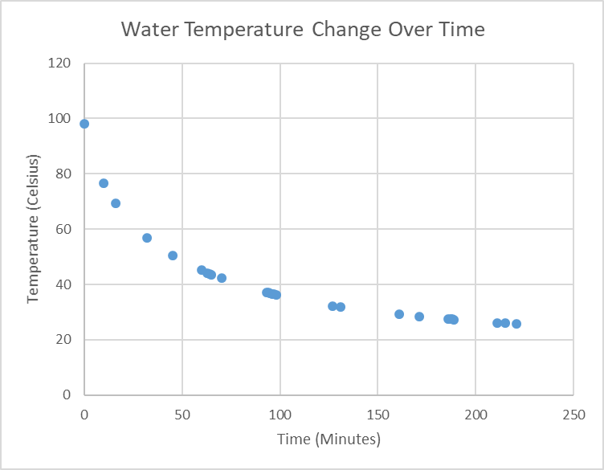
Real World Data – Cooling Water
The above data is the temperature of water (Celsius) in a mug after pouring in boiling water at time zero

Slide 5

Explore Scaling
Let’s investigate parameters for the pattern-book functions below
Please WRITE THEM DOWN
$$f\left(x\right)=m\left(x−x_{0}\right)+b$$
$$g\left(x\right)=m{\left(x−x_{0}\right)}^{2}+b$$
$$h\left(x\right)={Ae}^{k\left(x−s\right) }+C$$
$$j\left(x\right)=Asin\left(\frac{2π}{P}\left(x−B\right)\right)+C$$

Slide 6
Explore Scaling
Open Desmos: student.desmos.com
Use code MGHS4F, no need to login, but please enter your last name
Explore the effect of changing x₀ and m on functions f(x) and g(x)
What does changing x₀ do to the function?
What does changing m do to the function?
Explore the effect of changing s, k and A for function h(x)
What does changing s do to the function?
What does changing k do to the function?
What does changing A do to the function?
Explore the effect of changing A,B and C for function j(x)
What does changing A do to the function?
What does changing B do to the function?
What does changing C do to the function?

Slide 7
Scaling Functions
What does the value inside the parenthesis with your variable do to the function?
Shift horizontally
This is an example of input scaling
What does a multiplier do to the function?
Changes vertical behavior (slope/steepness/stretch)
A multiplier can be both an input (ex: k) and output (ex: A) scaler
What does the value that is added/subtracted outside of the parenthesis do to the function?
Shift vertically
This is an example of output scaling

Slide 8

Estimating a Model for Real World Exponential Data
In Desmos Activity 3 Water Cooling, explore the parameters for f(x) to estimate the model for the water cooling data
f$\left(x\right)={Ae}^{kx }+C$

Slide 9
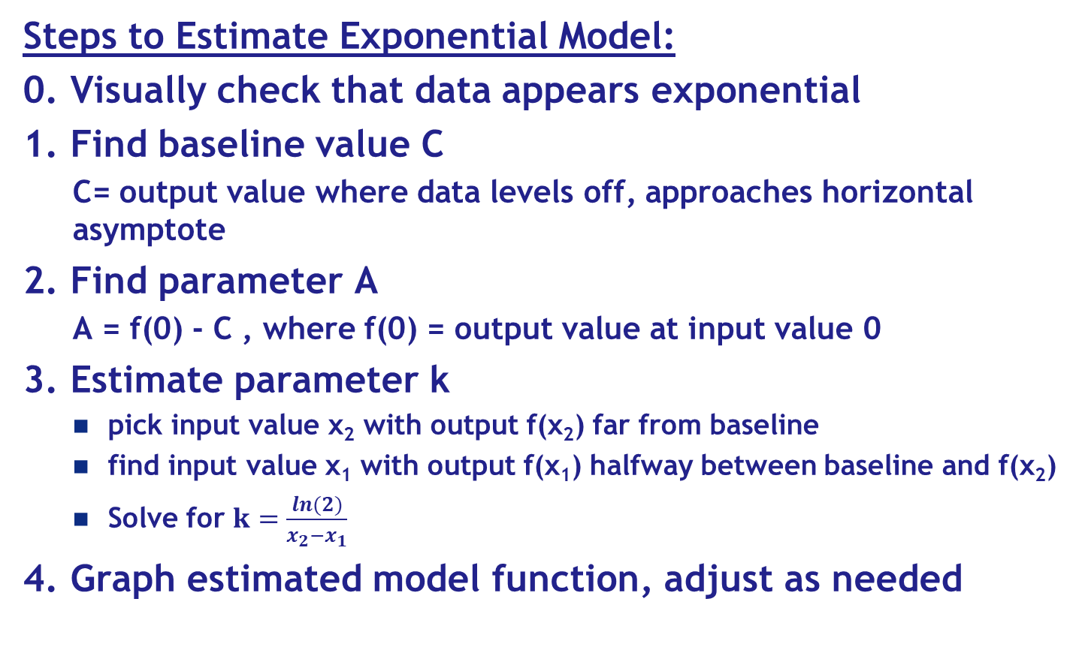
Estimating a Model for Real World Data – Exponential Process
Steps to Estimate Exponential Model:
0. Visually check that data appears exponential
1. Find baseline value C
C= output value where data levels off, approaches horizontal asymptote
2. Find parameter A
A = f(0) - C , where f(0) = output value at input value 0
3. Estimate parameter k
pick input value x₂ with output f(x₂) far from baseline
find input value x₁ with output f(x₁) halfway between baseline and f(x₂)
Solve for $k=\frac{ln(2)}{x_{2}−x_{1}}$
4. Graph estimated model function, adjust as needed

Slide 10
Estimating a Model for Real World Exponential Data
Time (Minutes) | Temperature (Celsius)
0 | 98.2
10 | 76.5
16 | 69.3
32 | 56.8
45 | 50.5
60 | 45.1
63 | 44.2
64 | 43.8
65 | 43.6
70 | 42.2
93 | 37.1
94 | 37
95 | 36.8
96 | 36.6
97 | 36.5
98 | 36.3
127 | 32.3
131 | 31.9
161 | 29.2
171 | 28.4
186 | 27.5
187 | 27.4
188 | 27.4
189 | 27.3
211 | 26.2
215 | 26.1
221 | 25.8

Slide 11
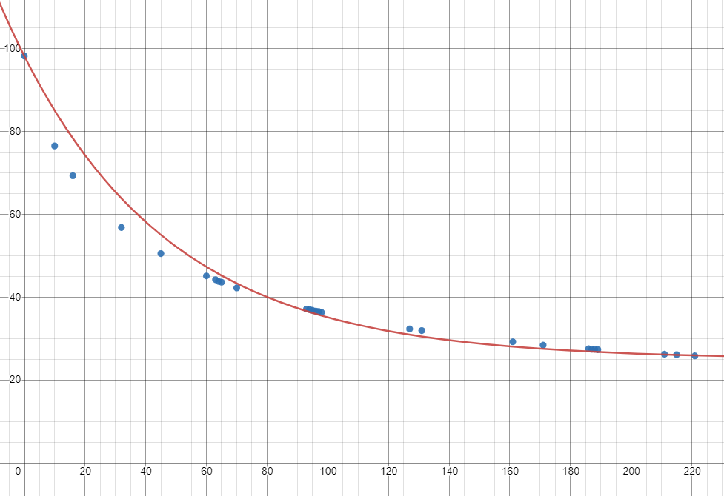
Estimating a Model for Real World Exponential Data - Solution
f(x) = 73.2e^{-0.0198x} +25

Slide 12
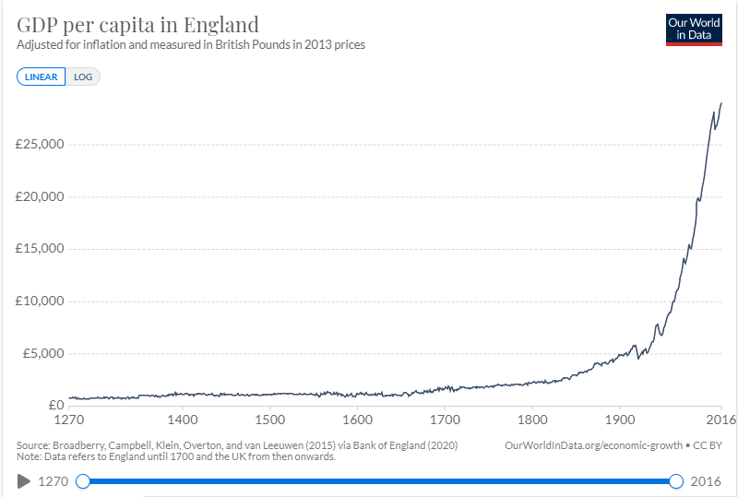
You Try! Estimating a Model for Real World Exponential Data
The Gross Domestic Product (in British pounds) for the United Kingdom has been recorded from 1270 until 2016
Estimate a model to represent the relationship between time and the GDP
Table of data and skeleton formula in Desmos Activity 4-GDP
Notes:
Something close to f(x) = 0.162e^{0.016x} +805
Or g(x) =0.005e^{0.021x} +800
GPD: monetary measure of good/services produced within a certain time period

Slide 13
Next Mission
What: Modeling with Parameterized Functions
When: M6 – Monday 23 August
Where: Assigned Classrooms on 5th Floor
Mission Prep (aka homework)
Read Chapter 8: Process of Modeling in text
DD05 – Due 24 August
DD06 – Due 26 August
HW02 –Due 1 September

Slide 14

Back Up Slides

Slide 15
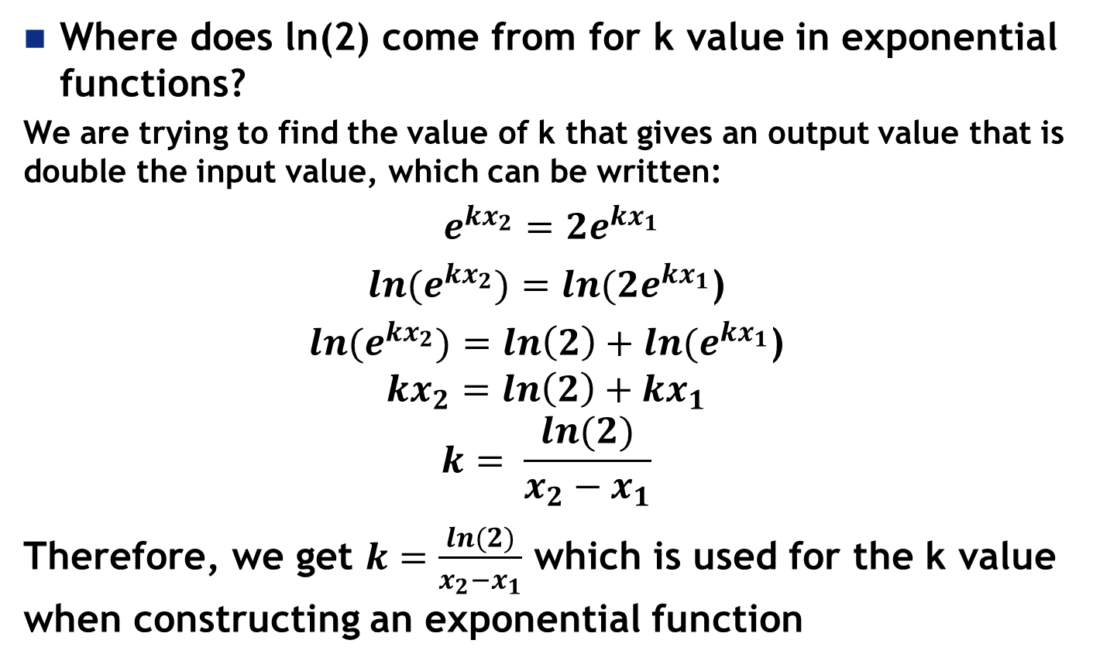
Back Up Slides
Where does ln(2) come from for k value in exponential functions?
We are trying to find the value of k that gives an output value that is double the input value, which can be written:
$e^{kx_{2}}=2e^{kx_{1}}$
$ln{(e}^{kx_{2}})={ln(2e}^{kx_{1}}$)
$ln{(e}^{kx_{2}})={ln\left(2\right)+ln(e}^{kx_{1}}$)
$${kx}_{2}={ln\left(2\right)+kx}_{1}$$
$$k= \frac{ln(2)}{x_{2}−x_{1}}$$
Therefore, we get $k=\frac{ln(2)}{x_{2}−x_{1}}$ which is used for the k value when constructing an exponential function

Slide 16
Lesson Links:
Text: https://dtkaplan.github.io/CalcZ-notes/process-of-modeling.html
Desmos: https://student.desmos.com/ Code: MGHS4F
Estimation Model Practice Desmos: https://www.desmos.com/calculator/pevdffd6dg

